Slide 1


Team Dolan
2
+
2
+
let’s fight this pandemic together

Slide 2




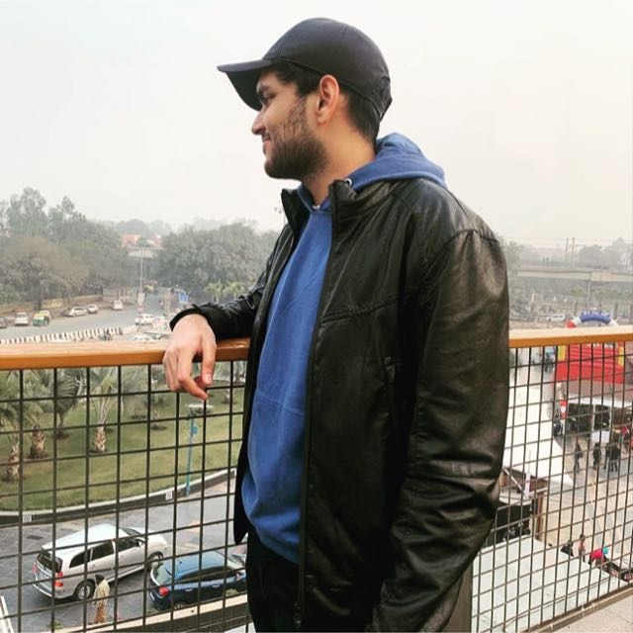
User Story
2
+
The Team
2
+
Rohan
Ujjawal
Aaryaman
The Team
What we experienced

Slide 3

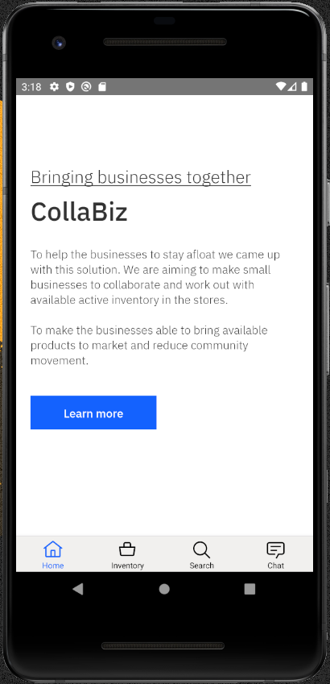
Solution
2
+
2
+
2
+
“CollaBiz”

Slide 4
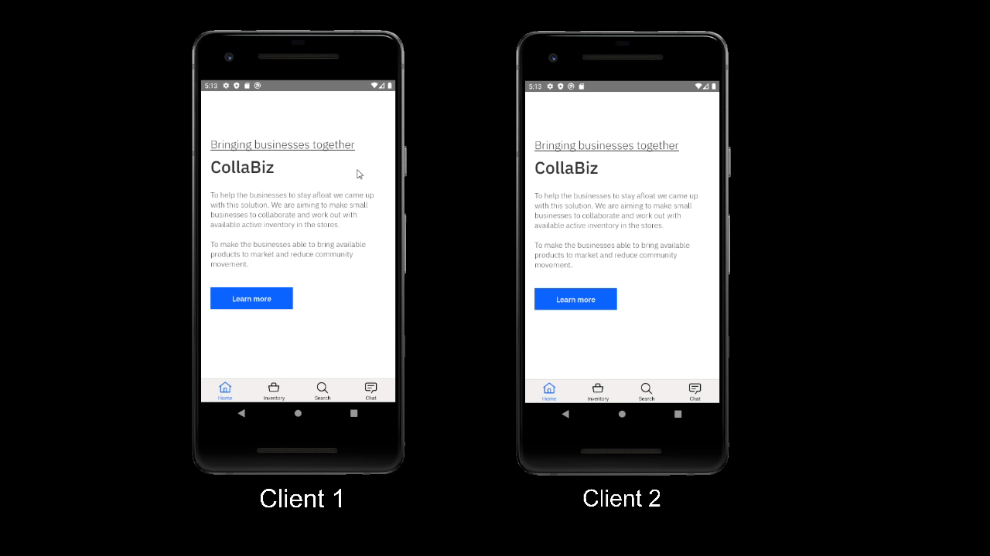
Demonstration
2
+

Slide 5
THANK YOU
2
+
2
+

